Slide 1
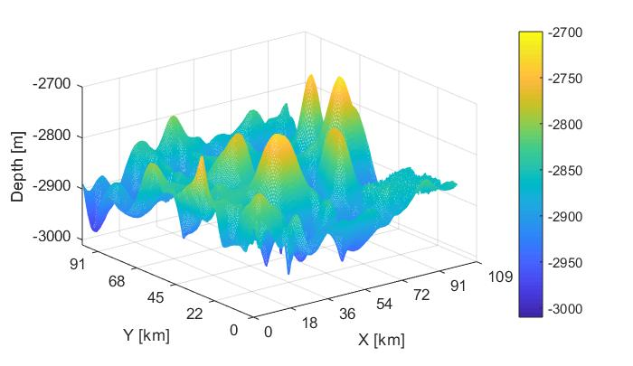
Bathymetry interpolation algorithms using AUV mission data
Alessia Annecchini
Alessia Guida
Lorenzo Irace
Giuseppe Longo

Slide 2
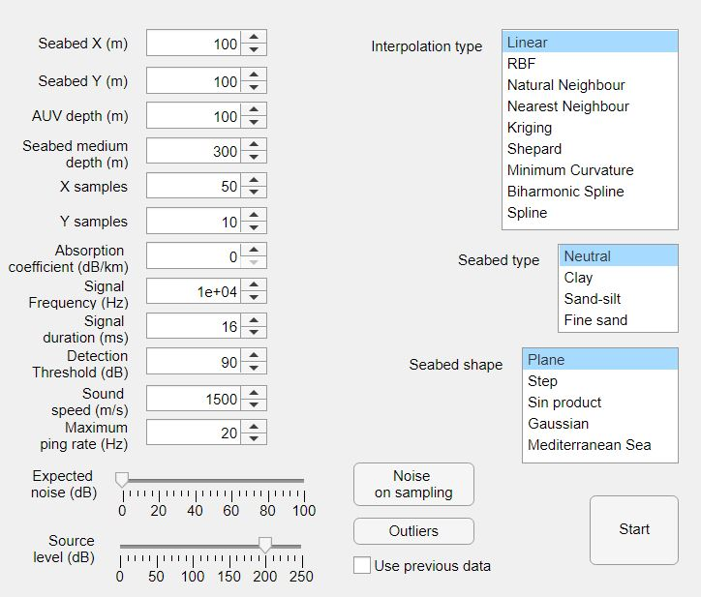
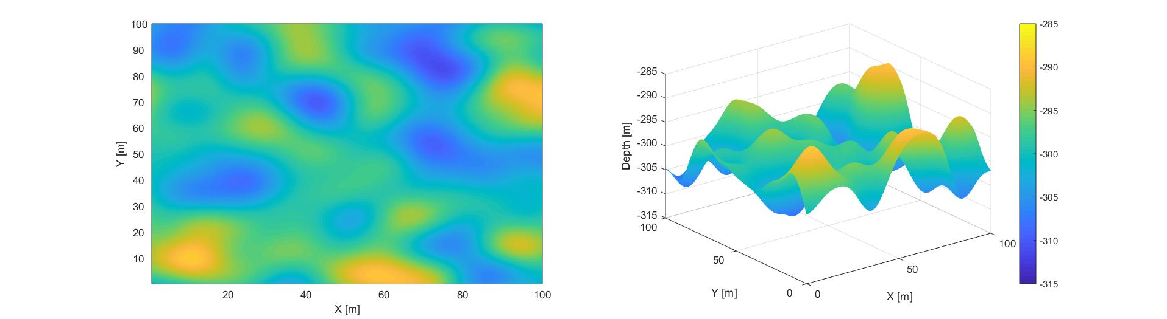
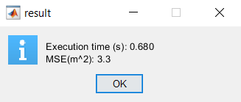
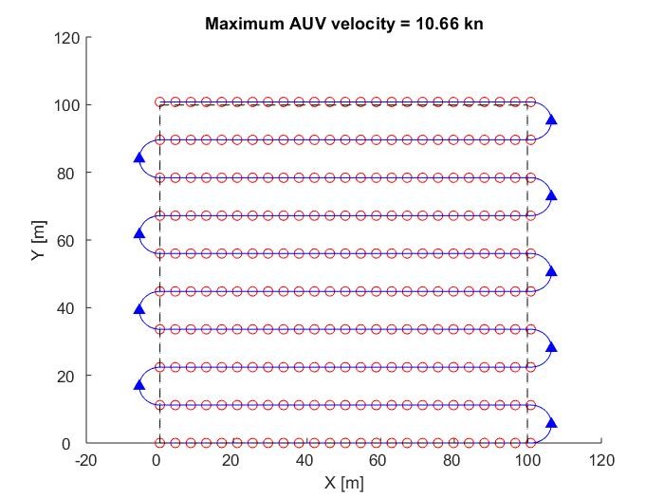
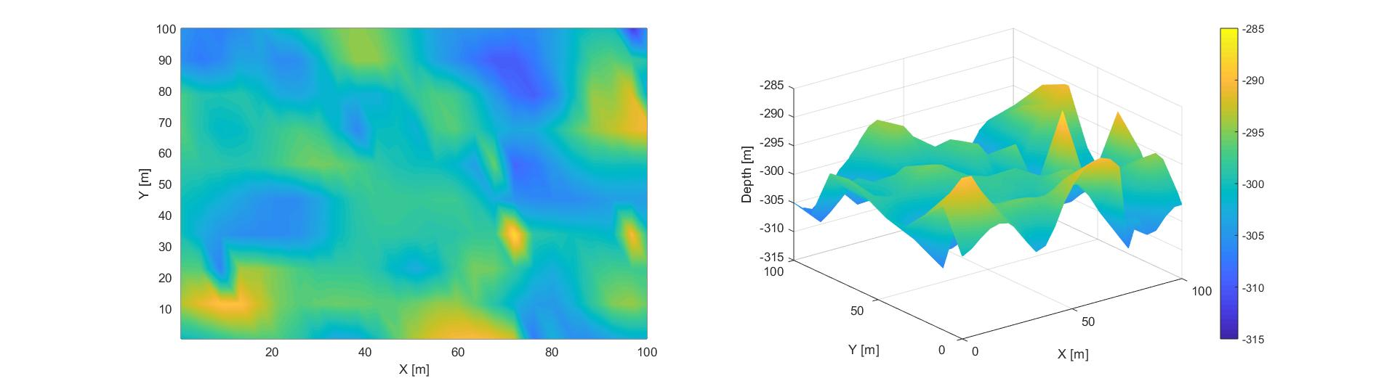
Project overview
Project goal: analysis of interpolation algorithms to reconstruct bathymetry from mission data
Echosounder single-beam (EA640 from Kongsberg Marine used as reference)
Software goal: Matlab GUI able to collect parameters set by user, to simulate mission and to apply interpolation algorithms

Slide 3
Project steps
Problem modeling
Algorithms
Performances evaluation
Conclusions

Slide 4
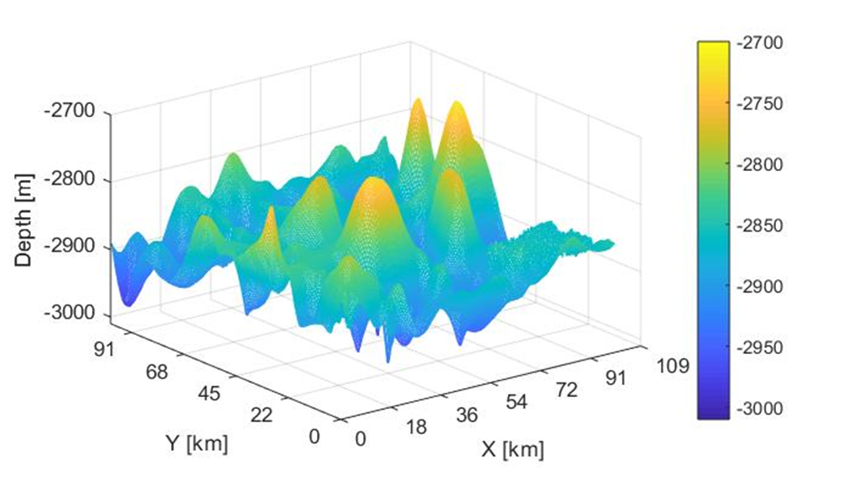

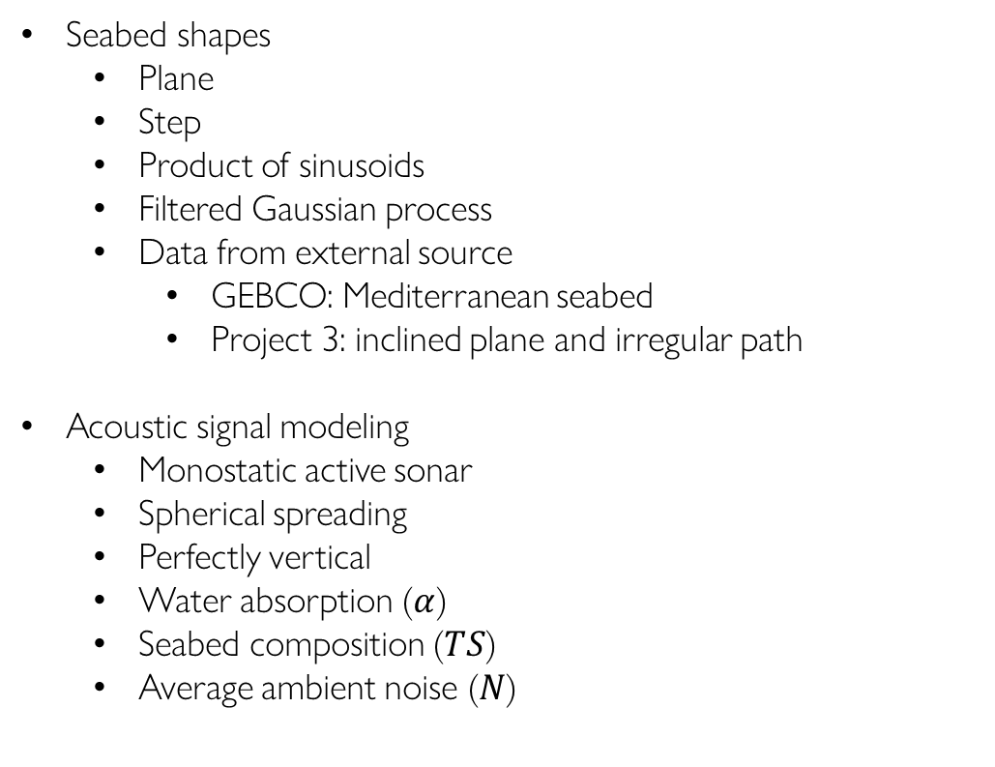
Problem modeling
Algorithms
Performances evaluation
Conclusions
Problem modeling
Seabed shapes
Plane
Step
Product of sinusoids
Filtered Gaussian process
Data from external source
GEBCO: Mediterranean seabed
Project 3: inclined plane and irregular path
Acoustic signal modeling
Monostatic active sonar
Spherical spreading
Perfectly vertical
Water absorption ($α$)
Seabed composition ($TS$)
Average ambient noise ($N$)
$$S=SL−2TL+TS$$
$$TL=20\log_{10}{R}+αR$$

Slide 5


Problem modeling
Algorithms
Performances evaluation
Conclusions
Problem modeling
Noise
White Gaussian
Small, not filtered
Outliers
Higher magnitude than noise
Randomly generated
Not perfectly rejected
Path
AUV considered as a point mass
Moving back and forth
No navigation error
No steering in the inspected area
Velocity constraints
No overlapping between consecutive signals
Ping rate bounded
$$v_{AUV}<\frac{∆x}{2T_{R}+T_{D}}$$
$v_{AUV}<$ ${(pr}_{MAX}+1) ∆x$

Slide 6

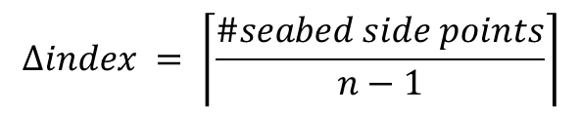
Problem modeling
Algorithms
Performances evaluation
Conclusions
Problem modeling
Samples density
Seabed represented as a matrix
Spaces between samples approximation
Constraint on the number of samples
Before data can go through algorithms we have…
$$∆index = \left\lceil \frac{\#seabed side points}{n−1}\right\rceil$$
$$\frac{\left\lceil ∆\right\rceil }{∆}≤\frac{n−1}{n−k−1}$$
Seabed generation
Mission simulation
Samples elaboration
Samples as signal power collected by sensor
Power to distance
Outliers rejection
Seabed matrix

Slide 7
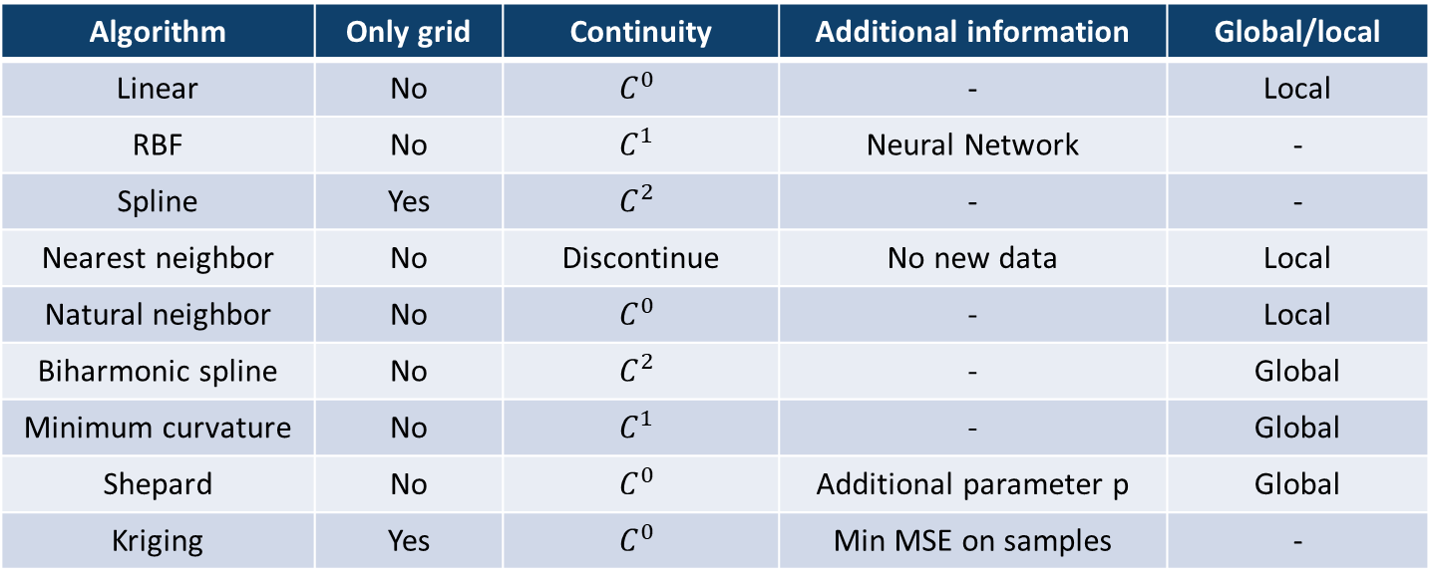
Problem modeling
Algorithms
Performances evaluation
Conclusions
Algorithms
Can require gridded or scattered data
Different computational cost
Different spatial subdivision
Different guaranteed continuity
Global or only local (irregular path)
Algorithm | Only grid | Continuity | Additional information | Global/local
Linear | No | $$C^{0}$$ | - | Local
RBF | No | $$C^{1}$$ | Neural Network | -
Spline | Yes | $$C^{2}$$ | - | -
Nearest neighbor | No | Discontinue | No new data | Local
Natural neighbor | No | $$C^{0}$$ | - | Local
Biharmonic spline | No | $$C^{2}$$ | - | Global
Minimum curvature | No | $$C^{1}$$ | - | Global
Shepard | No | $$C^{0}$$ | Additional parameter p | Global
Kriging | Yes | $$C^{0}$$ | Min MSE on samples | -

Slide 8
Problem modeling
Algorithms
Performances evaluation
Conclusions
Algorithms
Seabed
Depth samples
a
Mission
k
k < a, h < b
b
h
(X, Y)
Z
X-grid
Y-grid
Z-grid
Comparison
k*h
k*h
k
k
k
2
1
h
h
h
Scattered data
Gridded data
Interpolated seabed
a
Algorithm
b

Slide 9
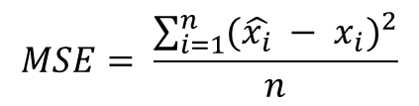
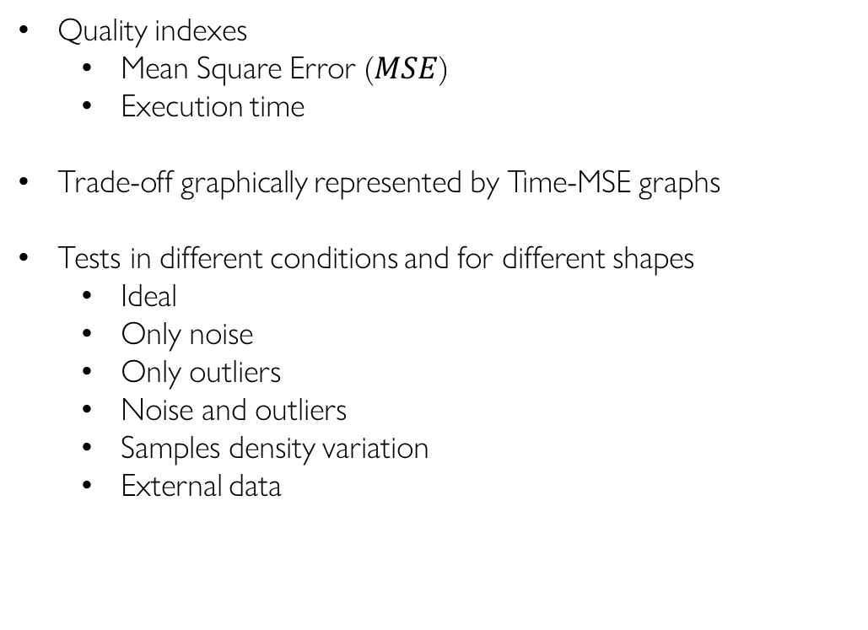
Problem modeling
Algorithms
Performances evaluation
Conclusions
Performances evaluation
Quality indexes
Mean Square Error ($MSE$)
Execution time
Trade-off graphically represented by Time-MSE graphs
Tests in different conditions and for different shapes
Ideal
Only noise
Only outliers
Noise and outliers
Samples density variation
External data
$$MSE= \frac{\sum_{i=1}^{n}{{(\hat{x_{i}} − x_{i})}^{2}}}{n}$$
Better
MSE
Best
Time

Slide 10
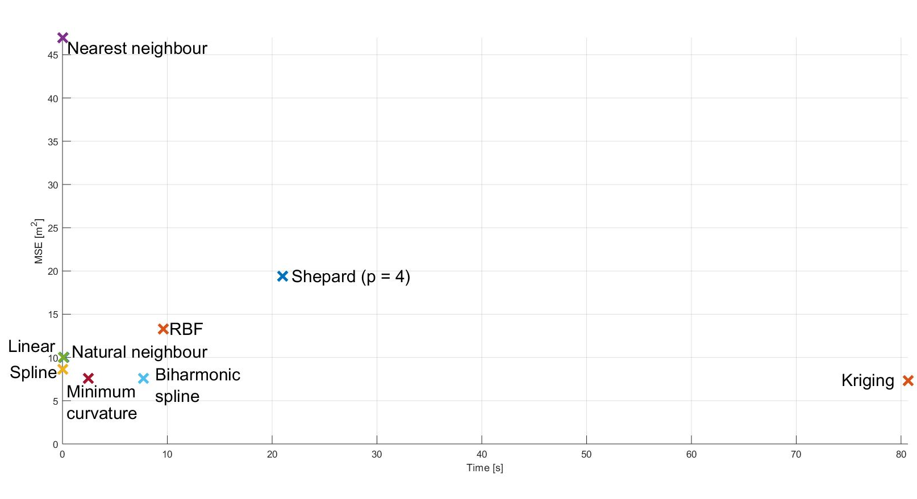
Problem modeling
Algorithms
Performances evaluation
Conclusions
Conclusions
No algorithm is comprehensively better than others
The algorithm must be chosen based on problem features
Real-time application
Linear interpolation
Natural neighbour interpolation
Spline interpolation
High quality results
Kriging interpolation
Minimum curvature interpolation
Interpolation quality is bounded by the presence of noise and outliers

Slide 11
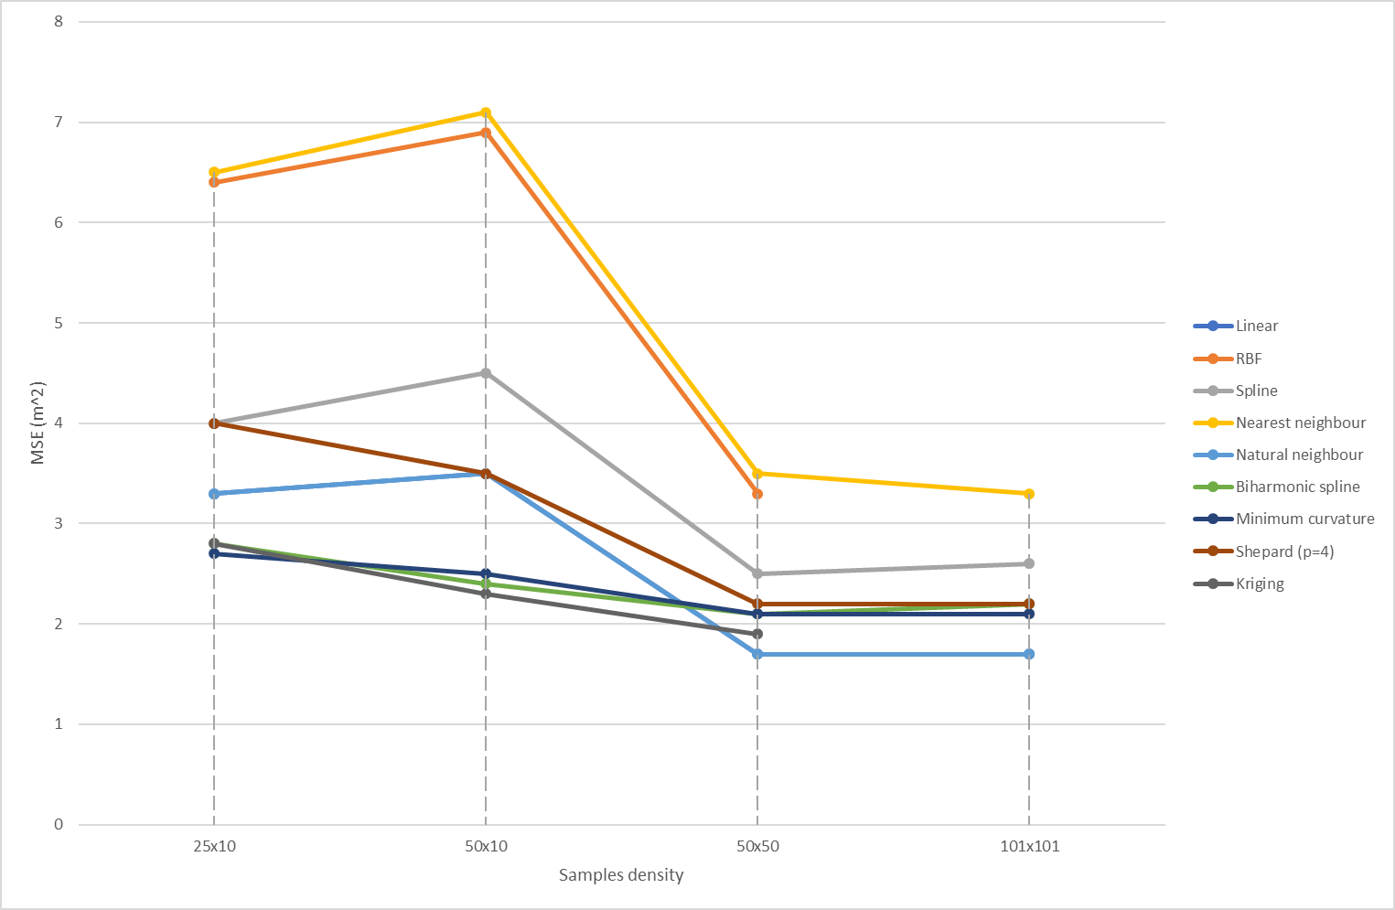
Problem modeling
Algorithms
Performances evaluation
Conclusions
Conclusions
Increasing the number of samples does not always imply higher quality due to imperfections

Slide 12
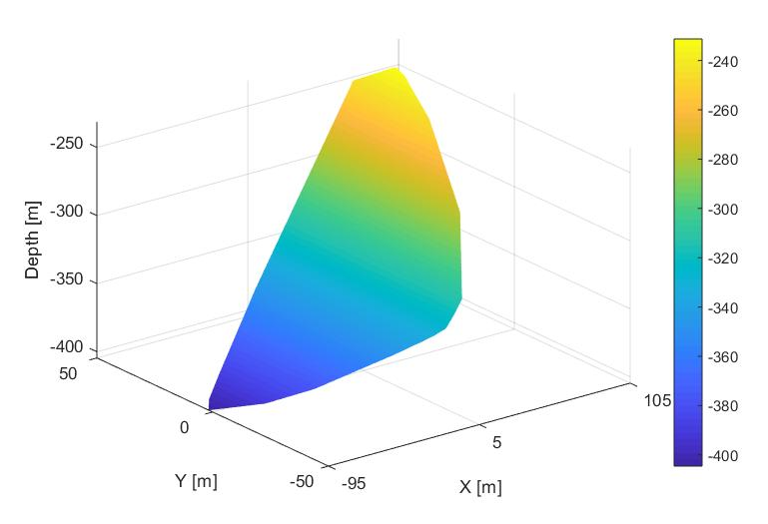
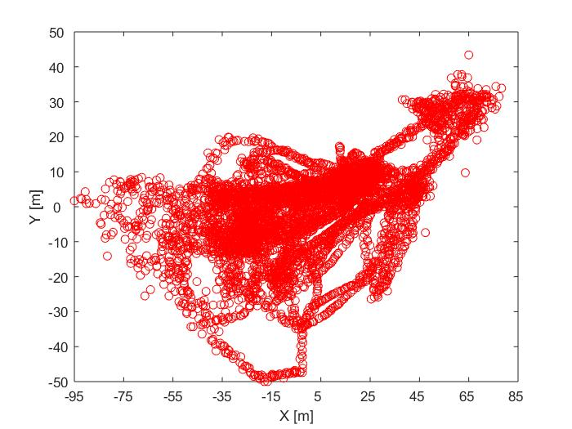
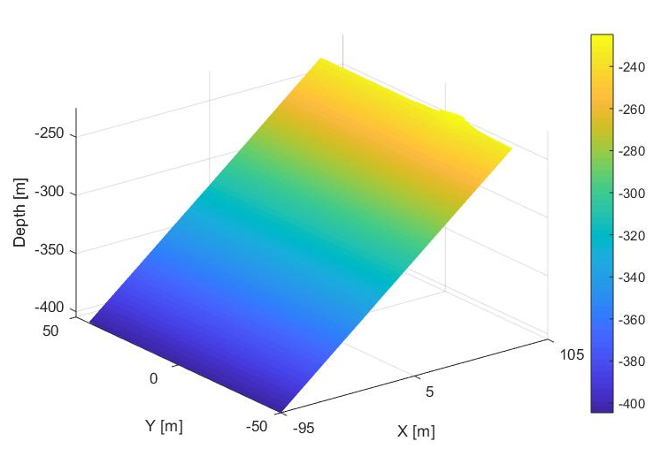


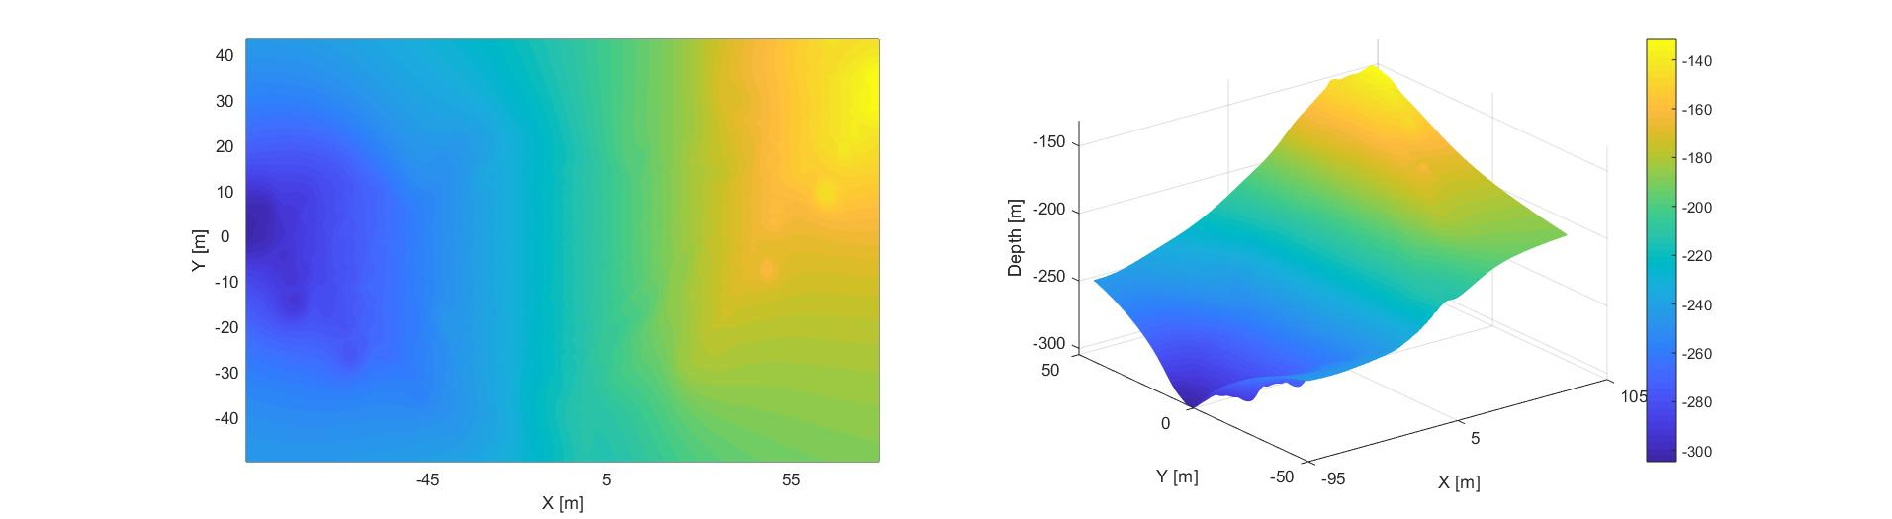

Problem modeling
Algorithms
Performances evaluation
Conclusions
Conclusions
If data do not cover the entire area a global interpolation seems more suitable than a local one, but good results are not always guaranteed
Natural neighbour interpolation
Minimum curvature interpolation
Shepard interpolation

Slide 13
Thank you
for the attention!

